Slide 1
Blazing Racer
Presented by Team 3D

Slide 2


Table of contents
Project idea
System components
Cutting-edge technology
Project proposal
Statement of work
Planned future work

Slide 3

Project Idea Before Professors Approval
The idea came from our brainstorming during the second in class meeting. The idea was iterated a bit more. With the game becoming more like a Mario cart-like game. ChatGPT was used to see what we could do for specific requirements need for the project. It did provide some interesting ideas.

Slide 4
Project Idea After Professors Approval
The idea overall is still the same with racing as the main concept. But with a few changes:
A race for the best time
No competing racers
A global leader board
One map only
Other changes...

Slide 5
System Components
The game is built on the cutting-tech Unity game engine and will feature full 3D graphics and physics.
Game will have global leaderboards stored in a database tracking and ranking fastest times for players anywhere and everywhere.
Will also feature an account system using a Google Account, which will be used allow players to backup saves to the account and act as a username for global leaderboards.

Slide 6

Cutting Edge Technology
As mentioned, Unity is consider cutting edge, here are some highlights:
Real-time 3D development
Cross-Platform Capability
Leaders on AR/VR development
And more
Our ideas before Prof. Wang told us that Unity was cutting edge were out of scope for this project.

Slide 7


Project Proposal Part 1
What was the project proposal about or how did it come about?
Initially, we had a solid foundation for the proposal of the project. But we later changed some ideas after a thorough talk with the professor
One of the proposals for the design of the map is incorporating Unity and Blender together.
The game is used for single-player.
Notes:
Made by Tanas part 1

Slide 8
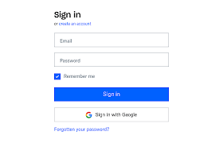

Project proposal Part 2
The login screen is going to be an Android Google login screen because just do not think that using an Apple ID is good enough and would d crash the game that were making.
The global ranking is going to be the big one to focus because there would be thousands upon thousands of people e trying to beat your time or just be the one person to take that number # 1 spot.
Notes:
Made by Tanas part 1

Slide 9
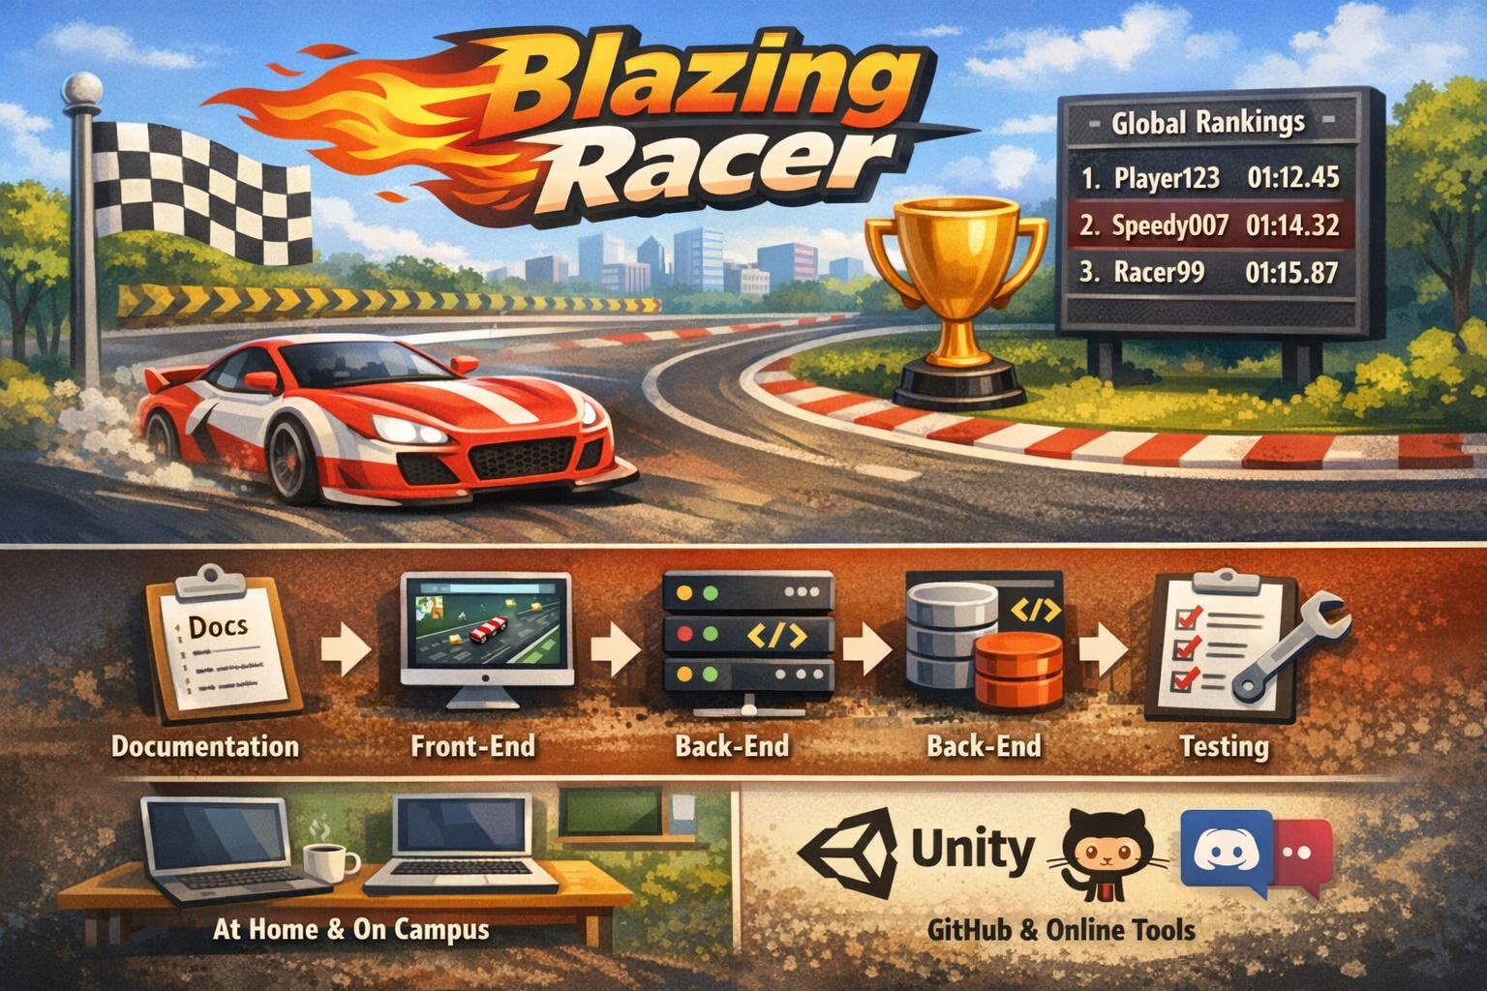
Statement of Work
Team project: Blazing Racer (Unity racing game)
Single-level game to keep it simple and lightweight
Focus on fast gameplay and a clean user interface
Main feature: global ranking system (database leaderboard)
Goal: keep the game fair so times and rankings are accurate
Notes:
For the Statement of Work, our team is building a Unity game called Blazing Racer. It is a top-down racing game with only one level. We are keeping it as a single-level game because our project needs to be lightweight, and we want to avoid adding too many packages or large features.
The most important feature of the project is the global ranking system. After the player finishes a race, the result will be saved into a database. Then the player can view a leaderboard and compare their best time with other players. Another important goal is fairness, so the ranking system should store accurate results and give every player the same chance.

Slide 10
Statement of Work
Period of Performance: Spring 2026 semester
Work is split into 4 phases
Phase 1: Documentation
Phase 2: Front-end
Phase 3: Back-end
Phase 4: Testing
End of each phase: team presentation of completed work
Place of Performance: at home and/or on campus
Tools: Unity, GitHub, online communication (Discord/email)
Notes:
The period of performance is the Spring 2026 semester, and we will complete the project in four phases. Phase 1 is documentation, where we plan the project and organize the work. Phase 2 is front-end development, which includes the user interface, controls, visuals, and a small tutorial. Phase 3 is back-end development, where we connect the database and create the ranking system. Phase 4 is testing, where we fix bugs and make sure the game works smoothly.
At the end of each phase, the team will give a presentation showing what we completed. The project will be developed on our computers at home or on campus, and we will share files using GitHub and communicate online.

Slide 11

Planned Future Work
Phase 2 (02/23 - 03/22):
Each member should create & setup a local Unity project using Unity Hub with the agreed upon version
Members tasked with the front-end workload should start planning & designing how the front-end should look & behave (UI, in-game assets, map design, controls, tutorial, etc). Implementation should also commence.
Members tasked with the back-end workload should start brainstorming how to piece it together with the front-end
Phase 3 (03/22 - 04/19):
Front-end development should have good progression at the start, with major progress being made by the end
Implementing the back-end for the database, login system, and game logic should begin

Slide 12
Planned Future Work Continued
Phase 4 (04/19 - 05/03):
Front-end should be fully implemented, with finalized testing & bug fixing being the primary focus
The back-end (database, login, game logic), should also be fully implemented, with finalized testing & bug fixing being the primary focus
Phase 5 (05/03 - 05/11):
Finalized testing should be concluded and the project, Blazing Racer, should be fully functional & playable

Slide 13

Q & A
Have any questions? Let us know!

